Slide 1
FUNCTIONS & STORAGE CLASSES

Slide 2
FUNCTIONS – AN INTRODUCTION
A function is a block of code that performs a specific task.
A function take input/s, do some specific computation and produces output.
All C programs contain at least one function, called main() where execution starts.

Slide 3
TYPES OF FUNCTIONS
There are two types of function in C programming:
Standard library functions
User-defined functions
Notes:
C language has two types of functions namely standard library functions and user defined functions

Slide 4
TYPES OF FUNCTIONS (Cont…)
Standard Library Functions:
The standard library functions are built-in functions in C programming.
These functions are defined in header files.
For example,
1. sqrt() - Calculates the square root of a number.
The function is defined in the math.h header file.
2. strlen() – Gives the length of the string.
The function is defined in the string.h header file.
3. printf() ,scanf() – Performs input and output functions.
The function is defined in the stdio.h header file.
Notes:
Standard Library Functions are basically the inbuilt functions in the C compiler that makes things easy for the programmer.
As we have already discussed, every C program has at least one function, that is, the main() function. The main() function is also a standard library function in C since it is inbuilt and conveys a specific meaning to the C compiler. Standard library functions allow the programmer to use the pre-existing codes available in the C compiler without the need for the user to define his own code

Slide 5
TYPES OF FUNCTIONS (Cont…)
User-defined function
User can also create functions as per the program requirement to solve the specific task. Such functions created by the user are known as user-defined functions.
Notes:
A User-defined functions on the other hand, are those functions which are defined by the user at the time of writing program. These functions are made for code reusability and for saving time and space.

Slide 6
ADVANTAGES OF FUNCTIONS
Improve Modularity
Large program can be divided into multiple small modules.
The program will be easier to understand, maintain, and debug.
2. Code Reusability
You can call a function multiple times, thereby allowing reusability and modularity in C programming.
It means that instead of writing the same code again and again for different arguments, you can call it multiple times by merely passing the various arguments.

Slide 7
DEFINING A FUNCTION
Syntax:
Return_type Function_name (parameter list)
{
Body of the function
}
Return type : Data type of the value that is returned. The return type can be of any data type such as int, double, char, void, short etc.
Function name: Meaningful name which describes the function’s task.
Arguments or Parameters: Arguments are the variable names along with their data types. These arguments are a kind of input for the function.
To use a function, that function is called using its name and arguments.
Notes:
The general form of a function definition in C programming language is as follows −
Return Type − A function may return a value. The return_type is the data type of the value the function returns. Some functions perform the desired operations without returning a value. In this case, the return_type is the keyword void.
Function Name − This is the actual name of the function. The function name and the parameter list together constitute the function signature.
Parameters − A parameter is like a placeholder. When a function is invoked, you pass a value to the parameter. This value is referred to as actual parameter or argument. The parameter list refers to the type, order, and number of the parameters of a function. Parameters are optional; that is, a function may contain no parameters.
Function Body − The function body contains a collection of statements that define what the function does.

Slide 8
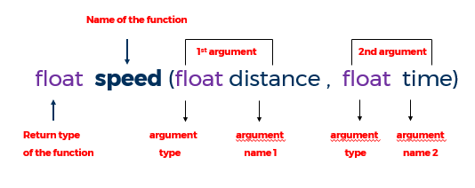
DEFINING A FUNCTION - Example

Slide 9
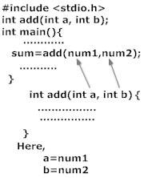
HOW TO USE USER DEFINED FUNCTION ?
To use a user-defined function,
the following steps are to be done:
Function declaration: This informs the compiler about the function name, function parameters and the data type of return value.
2. Function call : This calls the actual function.
3. Function definition: This contains all the statements to be executed.
Function Declaration /Prototype
Function call
Function Definition

Slide 10
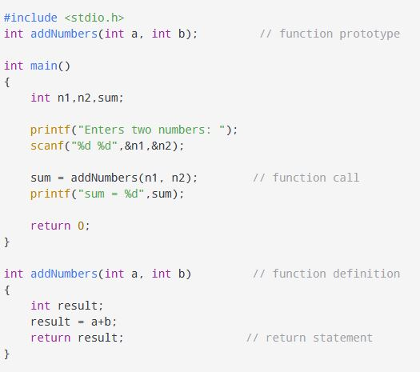
EXAMPLE

Slide 11
Function declaration
Function declaration in C always ends with a semicolon.
By default the return type of a function is integer(int) data type.
Function declaration is also known as function prototype.
Name of parameters is not compulsory in function declaration only their type is required. Hence the following declaration is also valid.
int getSum(int, int);
If the function definition is written before the main function then function declaration is not required
If the function definition is written after the main function then we must write the function declaration before the main function.

Slide 12
//function defined before main()
int getSum(int a, int b) {
return a+b;
}
int main(){
int a, b, sum;
printf("Enter two numbers\n");
scanf("%d %d", &a, &b);
sum = getSum(a, b);
printf("SUM = %d", sum);
return 0;
}
//function defined after main()
#include<stdio.h>
int getSum(int a, int b);
int main(){
int a, b, sum;
printf("Enter two numbers\n");
scanf("%d %d", &a, &b);
sum = getSum(a, b);
printf("SUM = %d", sum);
return 0;
}
int getSum(int a, int b) {
return a+b;
}

Slide 13
FUNCTION DECLARATION/PROTOTYPE (Cont…)
EXAMPLES :
float area_rectangle(int a, int b);
int diff(int a, int b, float c);
int equal(char a, char b) ;
int sum(int *a, int b);
int diff(int a[], int b);
int equal(float *a, char b);
Notes:
Here are a few examples for function declaration.

Slide 14
FUNCTION CALL
Function definition contains the block of code to perform a specific task.
When a function is called, the control of the program is transferred to the function definition. The compiler starts executing the codes inside the body of the function.
Notes:
Function definition – This contains all the statements to be executed.

Slide 15
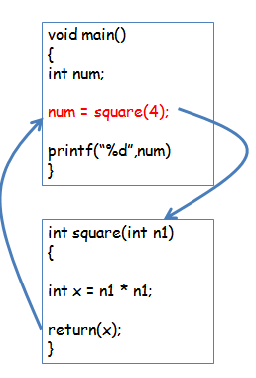
FUNCTION CALL ( Cont…)
EXAMPLE 2:
Function that calls another function is known as “calling function”
Function that is being called is known as “called function”
In example :
Calling function : main()
Called function : int square(int n1)
Notes:
AN example to calculate the square of a given number is given . It can be seen that main() is the calling function and square() is the called function

Slide 16
FUNCTION DEFINITION (Cont…)
Example 1:
int addNumbers (int a, int b) // function definition
{
int result; // local variable declaration
result = a+b;
return result; // return statement
}
Notes:
In the example, addNumbers is a function with 2 arguments a and b which are of type int . The functions adds a and b and stores the value in the result varible which is then returned to the calling function using the return statement

Slide 17
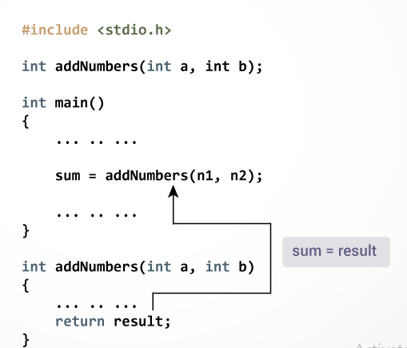
FUNCTION DEFINITION (Cont…)
EXAMPLE:
return Statement:
The return statement terminates the execution of a function and returns a value to the calling function.
The program control is transferred to the calling function after the return statement.
Syntax of the return statement
return expression;

Slide 18
FUNCTION DEFINITION return STATEMENT (Cont…)
EXAMPLES :
return 5; // returns a value
return (x); // returns a variable
return a+b; // returns a value after doing addition
return &p; // returns an address stored in p
return *p; // returns a value pointed by p

Slide 19
FUNCTION DEFINITION return STATEMENT (Cont…)
If There is No return ?
In C, one cannot skip the return statement when the return type of the function is non-void type.
The return statement can be skipped only for void types.
Not using a return statement in void return type function:
While using the void function, it is not necessary to use return as the void itself means nothing (an empty value).

Slide 20
No return
#include <stdio.h>
int main()
{
print();
return 0;
}
void print()
{
printf("Welcome to vit");
}
Output:
Welcome to vit
But if the return statement tries to return a value in a void return type function, that will lead to errors.
void func()
{
return value;
}

Slide 21
ACTUAL VS FORMAL PARAMETERS
Actual Parameters are written within the parenthesis at the time of function call in calling statement. Also called function arguments.
Formal Parameters are written within the parenthesis at the time of function definition. Or in the function header.
Notes:
Arguments which are mentioned in the function call is known as the actual argument. Arguments which are mentioned in the definition of the function is called formal arguments. Formal arguments are very similar to local variables inside the function.

Slide 22
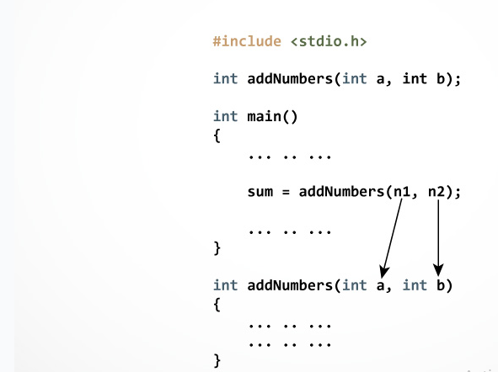
ACTUAL VS FORMAL PARAMETERS
In the example, two variables n1 and n2 are passed during the function call. These arguments are called actual parameters of the function.
The parameters a and b accepts the passed arguments in the function definition. These arguments are called formal parameters of the function.
Notes:
Let us see an example for actual and formal parameters
Order, number, and type of the actual arguments in the function call must match with formal arguments of the function.
If there is type mismatch between actual and formal arguments then the compiler will try to convert the type of actual arguments to formal arguments

Slide 23
PROGRAM EXAMPLE 1 Find the square of a number
#include<stdio.h>
float square(float);
void main()
{
float m, n ;
printf ("\nEnter some number for finding square \n");
scanf ( "%f", &m ) ;
n = square(m) ;
printf("\nSquare of the given number %f is %f",m,n);
}
float square(float x)
{
float p;
p=x*x;
return(p);
}
OUTPUT :
Enter some number for finding square
3
Square of the given number 3.000000 is 9.000000
Notes:
Let us see an example to find the square of the given number using functions.

Slide 24
PROGRAM EXAMPLE 2: Function to Calculate the Minimum of 2 Values
#include <stdio.h>
int min(int a, int b);
int main()
{
int j, k, m;
printf("\nInput two integers: ");
scanf("%d%d", &j, &k);
m = min(j, k);
printf("\nOf the two values %d and %d, the minimum is %d.\n\n", j, k, m);
return 0;
}
int min(int a, int b)
{
if (a < b)
return a;
else
return b;
}
OUTPUT :
Input two integers : 5 7
Of the two values 5 and 7 ,the minimum is 5

Slide 25
PRACTICE EXERCISE
1. Write a C program for the calculator application using functions.
2. Write a C program to find all prime numbers between given intervals using functions.

Slide 26
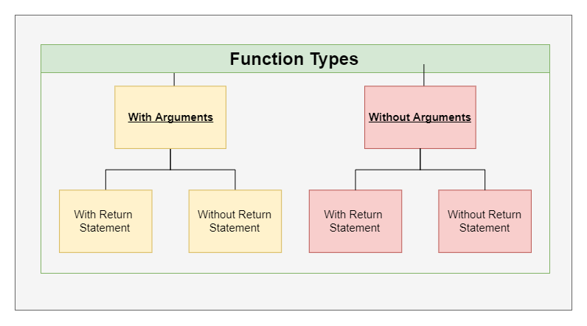
FUNCTION TYPES
Notes:
For better understanding of arguments and return in functions, user-defined functions can be categorised into 4 types:
Function with no argument and no Return value
Function with no argument and with a Return value
Function with argument and No Return value
Function with argument and Return value

Slide 27
FUNCTION TYPES (Cont…) EXAMPLE : SUM OF TWO NUMBERS
With arguments and with return values
#include <stdio.h>
int add(int,int); // Function Declaration
main()
{
int a=10,b=20,sum;
printf(“Addition”);
sum=add(a,b); // Function Call
printf(“sum = %d”,sum);
}
int add(int x, int y) // Function Definition
{
return x+y;
}
Output :
Addition
Sum=30

Slide 28
FUNCTION TYPES (Cont…) EXAMPLE : SUM OF TWO NUMBERS
2. With arguments and without return values
#include <stdio.h>
void add(int,int); // Function Declaration
main()
{ int a=10,b=20;
printf(“Addition”);
add(a,b); // Function Call
}
void add(int x, int y) // Function Definition
{
int sum;
sum= x + y;
printf(“sum = %d”,sum);
}
Output :
Addition
Sum=30

Slide 29
FUNCTION TYPES (Cont…) EXAMPLE : SUM OF TWO NUMBERS
3. Without arguments and with return values
#include <stdio.h>
int add(void); // Function Declaration
main()
{ int sum;
printf(“Addition”);
sum=add(); // Function Call
printf(“sum = %d”,sum);
}
int add(void) // Function Definition
{
int x=10,y=20;
return x+y;
}
Output :
Addition
Sum=30

Slide 30
FUNCTION TYPES (Cont…) EXAMPLE : SUM OF TWO NUMBERS
4. Without arguments and without return values
void add(void); // Function Declaration
main()
{
add(); // Function Call
}
void add() // Function Definition
{
int a=10,b=20,sum;
sum = a+b;
printf(“Addition”);
printf(“sum = %d”,sum);
}
Output :
Addition
Sum=30

Slide 31
CALL BY VALUE & CALL BY REFERENCE
There are two ways to pass value or data to function in C language which is given below:
Call by value
Call by reference
Notes:
functions can be invoked in two ways: which is known as Call by Value and Call by Reference.

Slide 32
CALL BY REFERENCE VS CALL BY VALUE
Call by Reference | Call by Value
This method copies the address of arguments into function as arguments. | This method copies the original value into function as arguments.
Actual and formal arguments share the same address space | Actual and formal arguments are stored in the different address space
Both the actual and formal parameters refer to the same memory locations and so, any changes made inside the function are reflected in actual parameters of the calling function. | Values of actual parameters are copied to function’s formal parameters and the two types of parameters are stored in different memory locations. So, any changes made inside functions are not reflected in actual parameters of the calling function.
Notes:
Call by reference method copies the address of an argument into the formal parameter. In this method, the address is used to access the actual argument used in the function call. It means that changes made in the parameter alter the passing argument.
All the operation in the function are performed on the value stored at the address of the actual parameter, and the modified value will be stored at the same address.
Call by value method copies the value of an argument into the formal parameter of that function. Therefore, changes made to the parameter of the main function do not affect the argument.

Slide 33
Call by Value
Within main
#include <stdio.h>
void fun(int,int);
void main()
{
int x=5, y=7;
fun(x,y); // call by value
printf("\nwithin main\n");
printf("x= %d y= %d ", x,y);
}
void fun(int x,int y)
{
x=7;
y=5;
printf("\nwithin fun\n");
printf("x= %d y= %d", x,y);
}
Var | x
Value | 5
memory | 1025
Var | y
Value | 7
memory | 1050
As fun is called by value, so copy of x=5 & y=7 will be sent to fun. But fun will change the values of x & y. As the value-changing activity is local, so it will not be reflected in the main
Within fun
Var | x
Value | 7
memory | 2025
Var | y
Value | 5
memory | 2050
OUTPUT:
within fun
x= 7 y= 5
within main
x= 5 y= 7

Slide 34
Call by Refences
Within main
#include <stdio.h>
void fun(int*,int*);
void main()
{
int x=5, y=7;
fun(&x, &y); // call by reference
printf("\nwithin main\n");
printf("x= %d y= %d ", x,y);
}
void fun(int* x, int* y)
{
*x=7; //is storing this value at the address of x
*y=5; //is storing this value at the address of y
printf("\nwithin fun\n");
printf("x= %d y= %d", *x,*y);
}
Var | x
Value | 5
memory | 1025
Var | y
Value | 7
memory | 1050
Here both actual and formal parameters refer to the same memory location. Therefore, any changes made to the formal parameter will get reflected in the actual parameter.
Within fun
Var | *x
Value | 1025
memory | 2025
Var | *y
Value | 1050
memory | 2050
OUTPUT:
within fun
x= 7 y= 5
within main
x= 7 y= 5

Slide 35
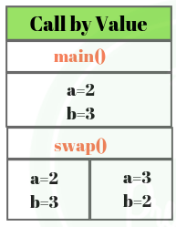
CALL BY VALUE – Swapping EXAMPLE
Call by Value
#include<stdio.h> void swap(int a, int b) { int temp; temp=a; a=b; b=temp; } void main() { int a=2, b=3; swap(a, b); // passing value to function printf("\nValue of a: %d",a); printf("\nValue of b: %d",b); }
Output:
Inside Function
Value of a: 3
Value of b: 2
Inside main
Value of a: 2
Value of b: 3
Notes:
Thus actual values of a and b remain unchanged even after swapping them. In call by value we cannot alter the values of actual variables through function calls.

Slide 36
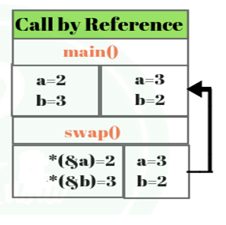
CALL BY REFERENCE – Swapping EXAMPLE
Call by reference
#include<stdio.h> void swap(int *a, int *b) { int temp; temp=*a; *a=*b; *b=temp; printf(“\n Inside Function”); printf("\nValue of a: %d",a); printf("\nValue of b: %d",b); } void main() { int a=2, b=3; swap(&a, &b); // passing value to function printf(“\n Inside main); printf("\nValue of a: %d",a); printf("\nValue of b: %d",b); }
Output:
Inside Function
Value of a: 3
Value of b: 2
Inside main
Value of a: 3
Value of b: 2
Notes:
In call by reference, original value is changed or modified because we pass reference (address). Here, address of the value is passed in the function, so actual and formal arguments shares the same address space. Hence, any value changed inside the function, is reflected inside as well as outside the function.
This method copy address of arguments into function as a arguments. Changes made to the parameter affect the argument. Because address is used to access the actual argument.

Slide 37
PASSING ARRAY TO A FUNCTION
To pass a list of elements as argument to any function in C language, it is preferred to do so using an array.
Declaring Function with array as a parameter
1.Have an array as a parameter.
Single array element or one-dimensional array or multidimensional
array can be passed as an argument to a function.
2. Have a pointer in the parameter list, to hold the base address of the array.

Slide 38
PASSING ARRAY TO A FUNCTION ( Cont …)
Returning an Array from a function
Pointer to the array holding the base address of the array to be returned.
SYNTAX EXAMPLE :
int sample (int* x[]) // Function Definition
{
…
…
…
return x ; // x is the base address of the array
}

Slide 39
PASSING ARRAY TO A FUNCTION (Cont …)
Passing a single array element to a function
Program Example :
#include<stdio.h>
void give_element (int a);
void main()
{
int myArray[] = { 2, 3, 4 };
give_element(myArray[2]); //Passing array element myArray[2] only.
}
void give_element(int a)
{ printf("%d", a); }
Output:
4

Slide 40
PASSING ARRAY TO A FUNCTION(Cont …)
Passing a one dimensional array to a function
EXAMPLE :
#include<stdio.h>
float findAverage(int marks[]);
int main()
{ float avg;
int marks[] = {99, 90, 96, 93, 95};
avg = findAverage(marks); // name of the array is passed as argument.
printf("Average marks = %f", avg);
return 0;
}
float findAverage(int marks[])
{ int i, sum = 0;
float avg;
for (i = 0; i <= 4; i++)
{ sum += marks[i]; }
avg = (sum / 5);
return avg;
}
Output:
94.6

Slide 41
PASSING ARRAY TO A FUNCTION (Cont…)
Passing a Two dimensional array to a function
EXAMPLE :
#include <stdio.h>
void print(int arr[3][3])
{
int i, j;
for (i = 0; i < 3; i++)
for (j = 0; j < 3; j++)
printf("%d ", arr[i][j]);
}
int main()
{
int arr[3][3] = {{1, 2, 3}, {4, 5, 6}, {7, 8, 9}};
print(arr);
return 0;
}
Output:
1 2 3 4 5 6 7 8 9

Slide 42
PASSING STRING TO A FUNCTION
A string is a sequence of characters enclosed with in double quotes terminated with a null character ‘\0’.
String is also termed as character array.

Slide 43
PASSING STRING TO A FUNCTION
EXAMPLE:
void printStr(char str[])
{
printf("String is : %s",str);
}
int main()
{
char str[] = “C Programming"; // declare and initialize string
printStr(str); // Passing string to the function
return 0;
}
OUTPUT:
C Programming

Slide 44
RECURSIVE FUNCTION - RECURSION
A function that calls itself is known as a recursive
function. This technique is known as recursion.

Slide 45
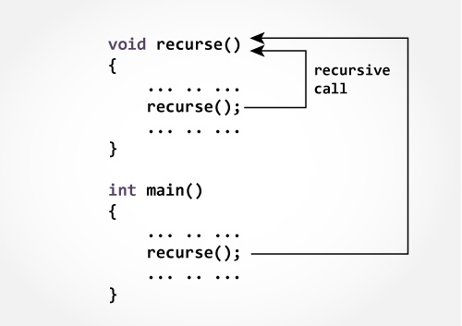
HOW DOES RECURSION WORKS?
Note :The recursion continues until some condition is met to prevent it.
To prevent infinite recursion, if...else statement (or similar approach) can be used where one branch makes the recursive call, and other doesn't.

Slide 46
PROGRAM EXAMPLE To find the factorial of a number n
#include<stdio.h>
long int fact(int n); // Function Declaration
int main()
{
int n;
printf("Enter a positive integer: ");
scanf("%d",&n);
printf("Factorial of %d = %ld", n, fact(n)); // Function Call
return 0;
}
long int fact(int n) // Function Definition
{
if (n ==1)
return 1;
else
return n*fact(n-1);
}
Output:
Enter a positive integer : 3
Factorial of 3 = 6

Slide 47
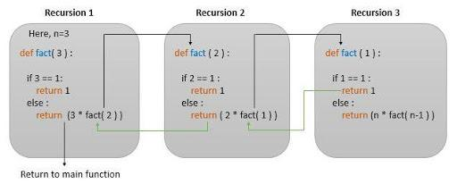
RECURSION (Cont…) HOW DOES THE PROGRAM WORKS ?

Slide 48
RECURSION EXAMPLE 2 Reverse a sentence using recursion
#include <stdio.h>
void reverseSentence();
int main()
{
printf("Enter a sentence: ");
reverseSentence();
return 0;
}
void reverseSentence()
{ char c;
scanf("%c", &c);
if (c != '\n')
{
reverseSentence();
printf("%c", c);
}
}
Output: Enter a sentence: program
margorp
This program first prints Enter a sentence: Then, reverseSentence() function is called.
This function stores the first letter entered by the user in c. If the variable is any character other than \n (newline), reverseSentence() is called again.
This process goes on until the user hits enter.
When the user hits enter, the reverseSentence() function starts printing characters from last.

Slide 49
PROGRAM FOR PRACTICE
Write a C program to find sum of digits of a given
number using recursion.
2. Write a C program to generate n^{th} Fibonacci series using recursion.

Slide 50
Fibonacci Series
#include <stdio.h>
int fib(int num)
{
if (num == 0)
return 0;
else if (num == 1)
return 1;
else
return fib(num - 1) + fib(num - 2);
}
int main()
{
int num;
printf("Enter the number of elements to be in the series : ");
scanf("%d", &num); // taking user input
for (int i = 0; i < num; i++)
{
printf("%d, ", fib(i)); // calling fib() function for each iteration and printing the returned value
}
return 0;
}

Slide 51
STORAGE CLASSES

Slide 52
STORAGE CLASSES
In C programming every variable is having two properties:
Type - refers to the data type of a variable
Storage class - determines the scope, visibility and lifetime of a variable.
Scope : The scope of a variable is the part of the program within which the variable can be accessed.
Visibility : The scope describes the visibility of a variable. A variable is visible within its scope and invisible or hidden outside it.
Life Time : The lifetime of a variable is the interval of time between
the memory allocation and release of the memory been allocated for a
variable.

Slide 53
STORAGE CLASSES
Four types of storage classes,
auto
external
static
register

Slide 54
Automatic - STORAGE CLASS (Local Variables)
Automatic variables are local variables that are declared with in a block/a function .
It can be accessed only inside the program block in which it is declared.
It is stored in stack in memory.
Default value is any random garbage value.
The life time is till the control remains within the block in which the variable is defined.

Slide 55
Automatic - STORAGE CLASS (Cont …) auto Keyword
Automatic variables declared using auto keyword
If nothing is declared, by default it is automatic.
Default storage class of all local variables.
Example :
void main()
{
auto int a; or int a; // Both are same
}

Slide 56
Automatic - STORAGE CLASS (Cont…) How it works ?
void main()
{
int n1; // n1 is a local variable to main()
}
void func()
{
auto int n2; // n2 is local variable to func()
}

Slide 57
Automatic STORAGE CLASS (Cont …) EXAMPLE
#include <stdio.h>
void main( )
{
auto int j = 1;
{
auto int j= 2;
{
auto int j = 3;
printf ( " %d ", j);
}
printf ( "\t %d ",j);
}
printf( "%d\n", j);
}
Output:
3 2 1

Slide 58
Static– STORAGE CLASS
A static variable tells the compiler to persist/save the variable until the end of program.
A local or a global variable can be a static variable.
Static local variable is declared with in a function/block. Its life time is till the program terminates.
Static global variable is declared outside of all the functions. Its life time is till the program terminates.
Default value is 0

Slide 59
Static
#include<stdio.h>
static char c;
static int i;
static float f;
static char s[100];
void main ()
{
printf("%d %d %f %s",c,i,f,s[]); // the initial default value of c, i, and f will be printed.
}
Output:
0 0 0.000000 (null)

Slide 60
Static – STORAGE CLASS (Cont…)
Static Variables are declared using static keyword.
#include<stdio.h>
void test(); //Function declaration
void main()
{
test();
test();
test();
}
void test()
{
static int a = 0; //a is static local variable
a = a + 1;
printf("%d\t",a);
}
#include<stdio.h>
void test(); //Function declaration
void main()
{
test();
test();
test();
}
void test()
{
int a = 0; // a is auto local variable
a = a + 1;
printf("%d\t",a);
}
Output:
1 2 3
Output:
1 1 1

Slide 61
External – STORAGE CLASS (Global Variables)
Variables that are declared outside of all functions are known as external or global variables.
They are accessible from any other function inside the program.
Default value is zero.
The value is assigned to it in a different block and this can be overwritten/changed in a different block.
The lifetime is till the program terminates.

Slide 62
EXTERNAL – STORAGE CLASS GLOBAL VARIABLE (Cont…) EXAMPLE
#include <stdio.h>
void display(); // function declration
int n = 5; // global variable
int main()
{ ++n;
display();
return 0;
}
void display()
{
++n;
printf("n = %d", n);
}
Output:
n=7

Slide 63
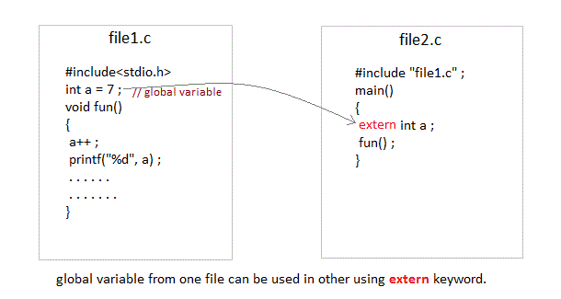
External – STORAGE CLASS (Cont..) extern KEYWORD USAGE
To access a global variable (declared in file1) in a different file file2, keyword
extern is used in file2 to indicate that the external variable is declared in another file.

Slide 64
External- Example
#include <stdio.h>
int main()
{
extern int a;
printf("%d",a);
}
Output
main.c:(.text+0x6): undefined reference to `a'
collect2: error: ld returned 1 exit status
#include <stdio.h>
int a;
int main()
{
extern int a; // variable a is defined globally, the memory will not be allocated to a
printf("%d",a);
}
Output
0

Slide 65
Register – STORAGE CLASS
Register variables are very similar to the auto variables. The difference is the storage. Register variables are stored in CPU registers. Register variables are accessed faster than the local variables.
Lifetime is till the end of function/method block, in which the variable is defined.
The initial default value of a register is 0.
NOTE: We can never get the address of such variables.

Slide 66
Register – STORAGE CLASS
Register variables declared using register keyword
Example :
void main()
{
register int a;
}

Slide 67
Register
#include <stdio.h>
int main()
{
register int a; // variable a is allocated memory in the CPU register. The initial default value of a is 0.
printf("%d",a);
}
Output:
0

Slide 68
Register – STORAGE CLASS EXAMPLE
Example 1:
#include <stdio.h>
void main()
{
register int a;
printf("%d",a);
}
Example 2:
#include <stdio.h>
void main()
{
register int a = 0;
printf("%u“, &a);
}
Example 1:
Output :
0
Explanation: variable a is allocated memory in the CPU register.
The initial default value of a is 0.
Example 2:
Output :
main.c:5:5: error: address of register variable a requested
Explanation:
This will give a compile time error since we can not access the address of a register variable.

Slide 69
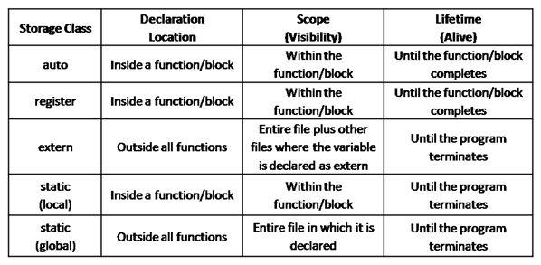
STORAGE CLASSES -A RECAP

